Slide 1
Week 4 AERO 222 Lab
Aitken’s accelerating linear convergence
Compare the fixed point method from last week to a faster method for convergence

Slide 2
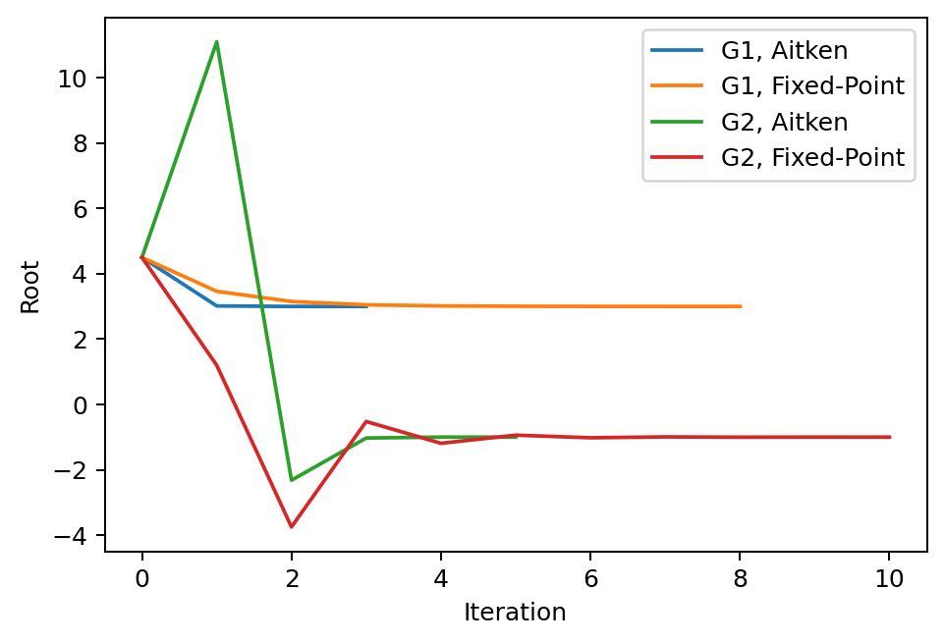
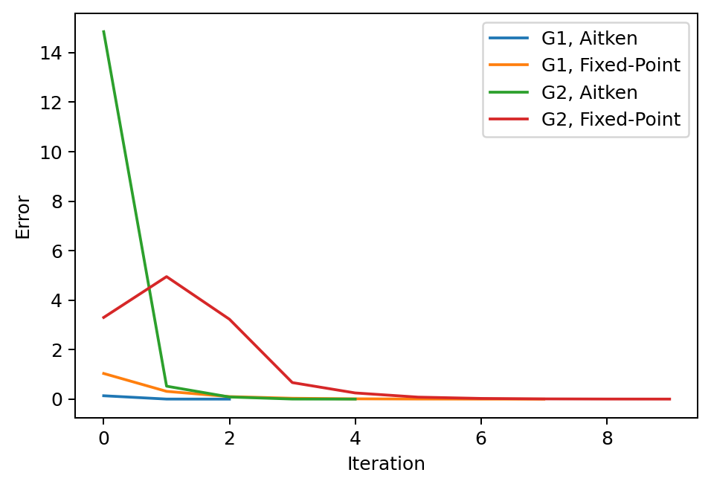
Problem Assignment
Given the equation x^2 – 2x – 3:
Find the roots using Aitken’s accelerating linear convergence for the fixed point method
Start at x = 4.5
Only use g1 and g2 from last week
Set ϵ = 0.001
Repeat iterative convergence and compare to last week’s fixed point iteration
Compare the convergence using Aitken’s flowchart to last week’s fixed point method
Plot the convergence of the errors and x
Set convergence criteria as abs(x_new – x_old)

Slide 3
Fixed-point iteration: “x = g(x)” method

Slide 4
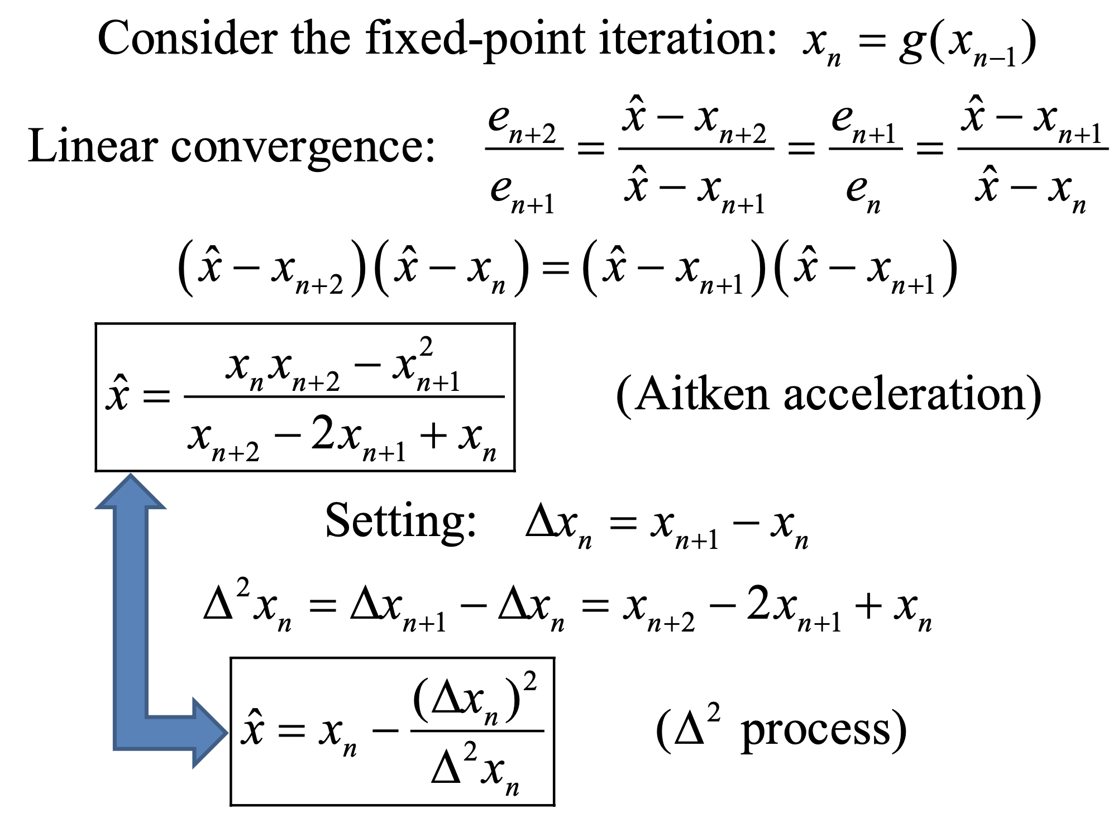
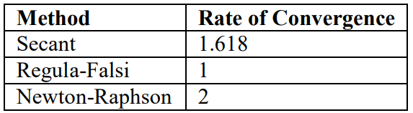
Accelerating linear convergence

Slide 5
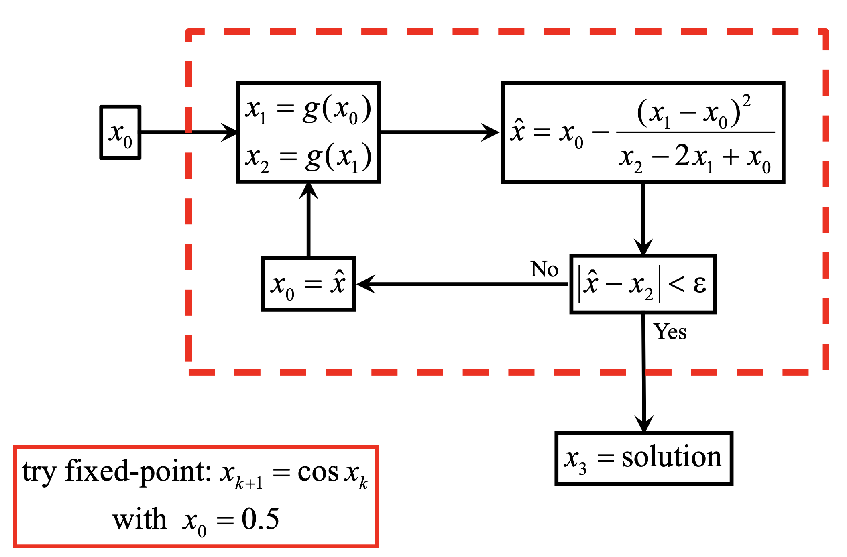
Aitken Flowchart (fixed point)

Slide 6
Define your equations as functions
Test them out, make sure they return the correct values
Initialize your lists
Includes anything you need to track or plot
Determine your iterative
What error or an independent variable are you trying to converge?
Iterate to your solution
Keep track of which variables are inside your loop
What types of values are they?
Are you overwriting any values you need later?
End when stopping criteria is met
Plot your solution
Matplotlib.pyplot.plt
plt.plot(xList, yList (optional)) is the simplest plot
For logarithmic axis:
plt.loglog() plots both axis as log scale, plt.semilogx() plots the x axis as log scale, plt.semilogy() plots the y axis as log scale
Other tips:
Defined functions only track their specified inputs and outputs
If you redefine a variable later in your main script, it will not remember the previous value
If you redefine a single value in a list or array, it will update the array and keep the other array values
If you append a list, it will add the value to the end of the list
Use brackets for indices, parenthesis for calling functions and (if necessary) grouping/order of operations
Parenthesis immediately after a word will likely be treated as a function call
Square brackets immediately after a word will likely be treated as the index of a list or matrix
Someone, somewhere has probably run into the same problem before
Googling your errors or problems is a legitimate way to find programming solutions

